Slide 1
Introduction to Decision Trees

Slide 2
Before Starting the Course
Upon completion of this course, you will have acquired general knowledge of introductory artificial intelligence algorithms and data analysis.
Since the specific topics are difficult to understand and it will not be easy for the person to settle the logic during the lesson, a lot of individual practice is required.
Slides will be explained with visuals without drowning in texts. That is why it is extremely important to take notes during the lesson.
Since the titles are sufficient for basic level algorithms, the titles should be researched, and research should be done on sites that contain plenty of practice and theoretical information.

Slide 3
Mert Çobanov
Github: cobanov
Linkedin: mertcobanoglu
Twitter: mertcobanov

Slide 4


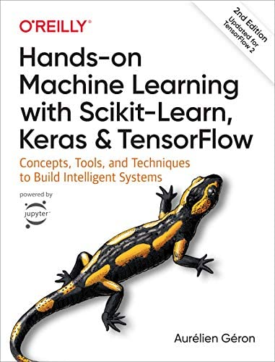
Sources
Deep Learning Türkiye
Hands-on Machine Learning with Scikit-Learn, Keras & TensorFlow
Aurelien Geron
Stanford University
stanford.edu/~shervine/
Shervine Amidi

Slide 5
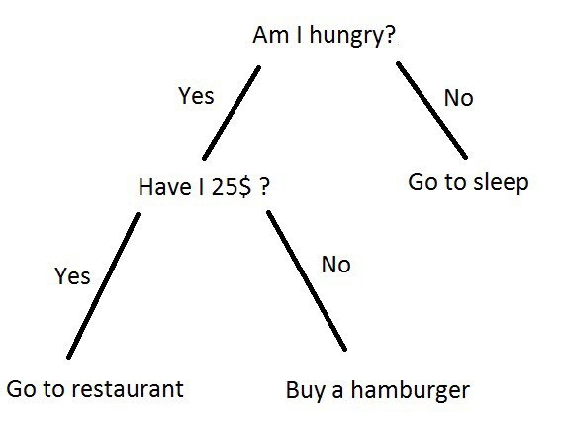
Decision Trees
A decision tree uses a tree structure to represent a set of possible decision paths and an outcome for each path.
The decision tree is one of the most commonly used classification techniques.
It is very easy to understand and interpret and the process of arriving at an estimate is completely transparent.

Slide 6
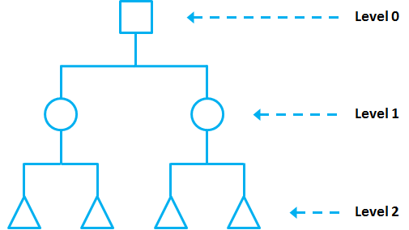
Structure of Decision Trees
Root: The first cells of the decision trees are called the root (root or root node). Each observation is classified as “Yes” or “No” according to the root condition.
Node: Root cells contain nodes (interval nodes or nodes). Each observation is classified with the help of nodes. The complexity of the model increases as the number of nodes increases.
Leaf: At the bottom of the decision tree are leaves (leaf nodes or leaves). The leaves give us the result.

Slide 7
Decision Trees Application

Slide 8
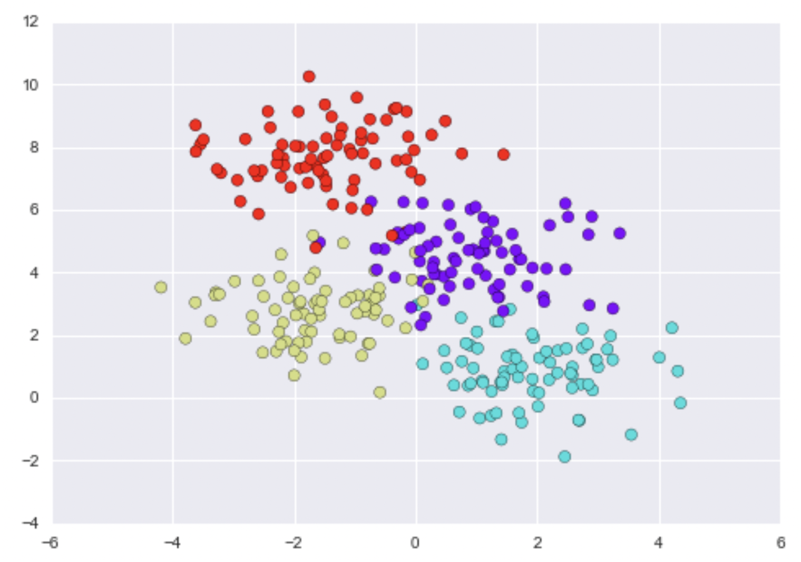
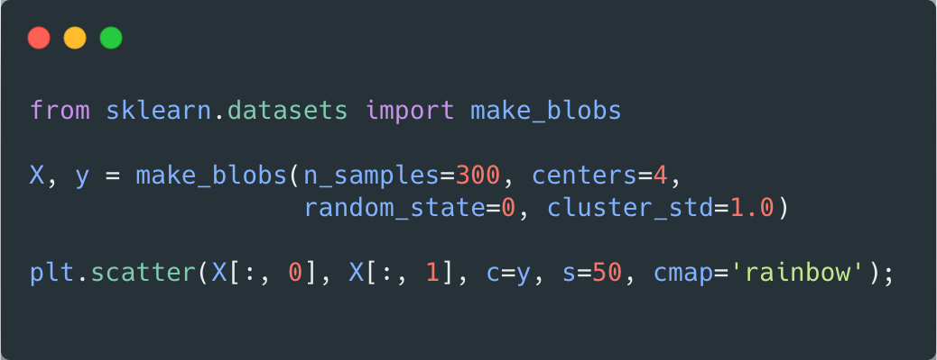
Decision Trees Application
Let's examine the following two-dimensional data, which has four class labels

Slide 9
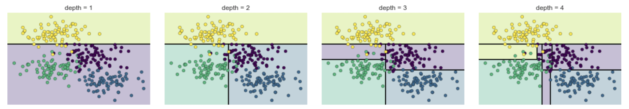
Decision Trees Application
A simple decision tree built on this data will iteratively split the data along one or the other axis according to some quantitative criteria and, at each level, assign the label of the new region by a majority vote of the scores in it.
Note that after the first split, every point in the parent branch remains unchanged, so there is no need to further subdivide this branch. At each level, each region is split again along one of the two features, except for nodes containing an entire color.

Slide 10
How to Calculate Decision Trees

Slide 11
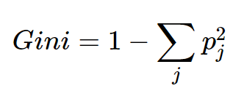
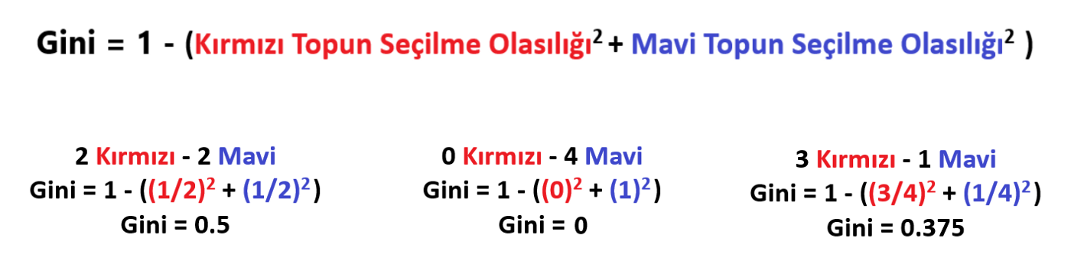
Gini Index
Pure, means that all data in a selected dataset instance belongs to the same class.
Impure, means that the data is a mix of different classes.
Gini Impurity, It is a measure of the probability that a new sample of a random variable will be misclassified if a new sample is randomly classified based on the distribution of class labels from the dataset.
If our dataset is Pure, the probability of misclassification is 0. If our sample is a mix of different classes, the probability of misclassification will be high.

Slide 12
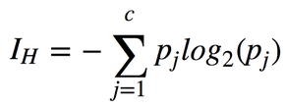
Entropy
To construct a decision tree, we need to decide which questions to ask and in what order. At each stage of the tree there are some possibilities that we eliminate and some that we do not.
Example: After we learned that an animal has no more than five legs, we eliminated the possibility of being a grasshopper. We didn't rule out the possibility of it being a duck. Each possible question segments the remaining probabilities according to their answers.
Entropy is a measure of the uncertainty of a random variable. The higher the entropy, the more information obtained.

Slide 13
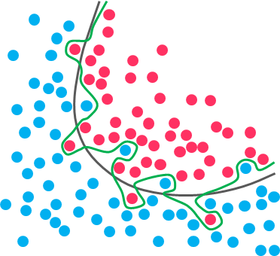
Decision Trees Advantages
It can work with both continuous and discrete data
It needs less data preprocessing. Does not require outlier detection or scaling
Decision trees are easily visualized and classification rules are clearly visible so they are easy to understand and interpret
It can be used for multiple output

Slide 14
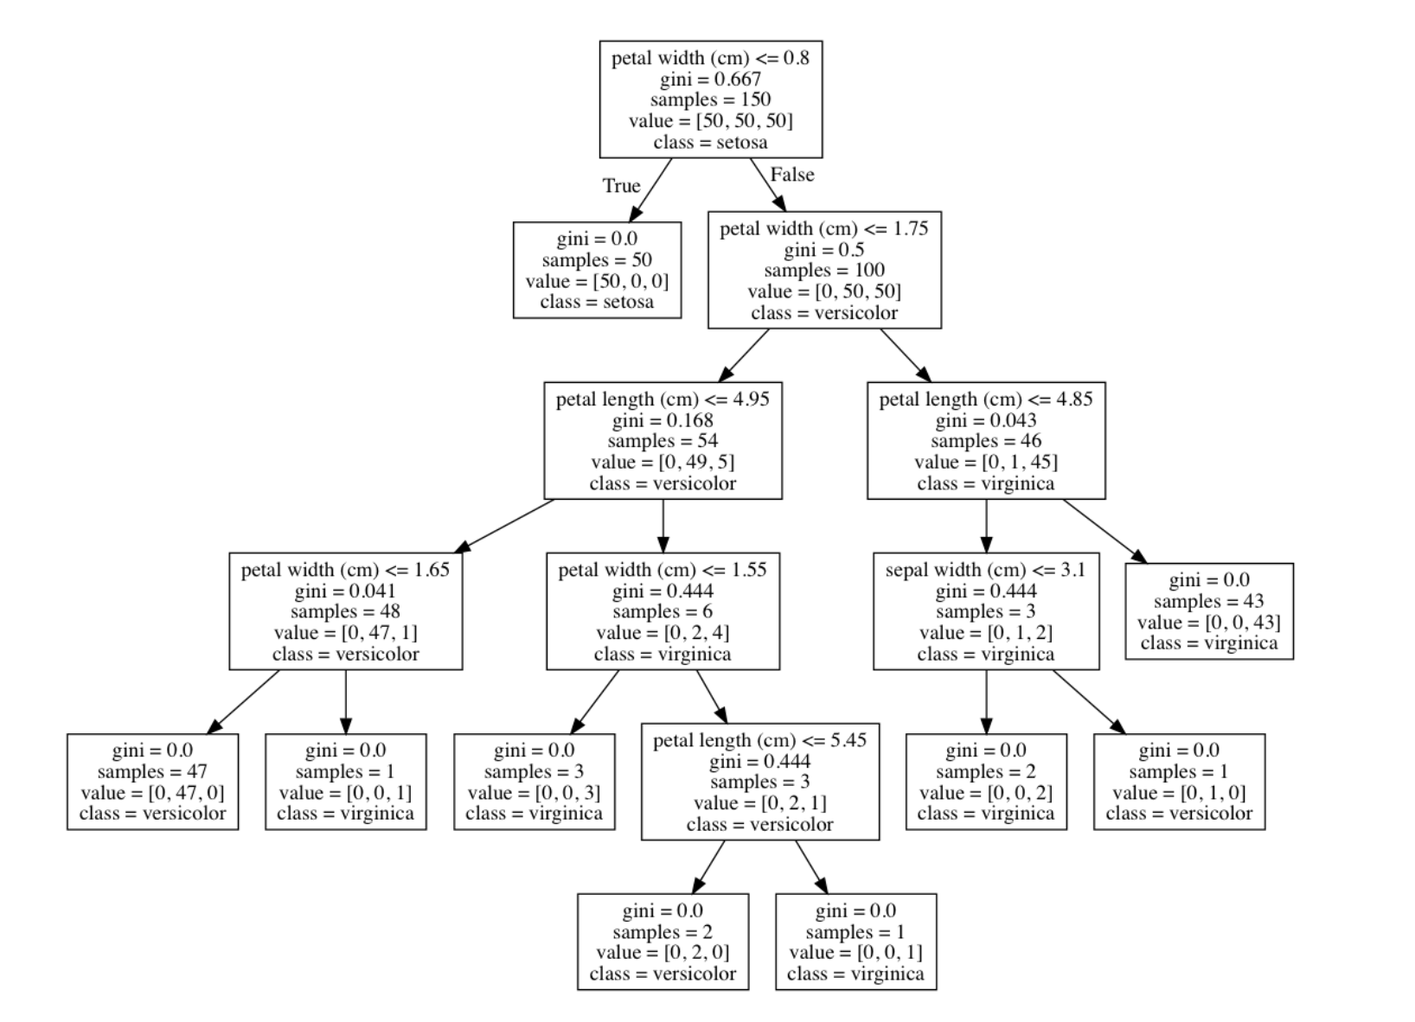
Decision Trees Visualization

Slide 15
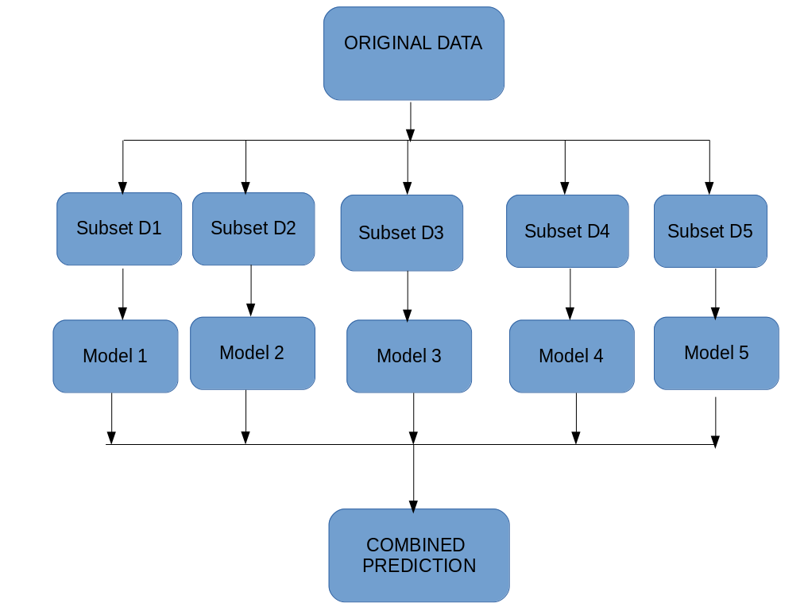
Ensemble Learning
More than one classification is called the event that the estimation algorithm gives more successful results with the logic of working together.
Example: Random forest is the drawing of more than one decision tree algorithm for the same problem several times and using them together to solve the problem.
Max Voting
Averaging
Weighted Averaging
Stacking
Blending

Slide 16
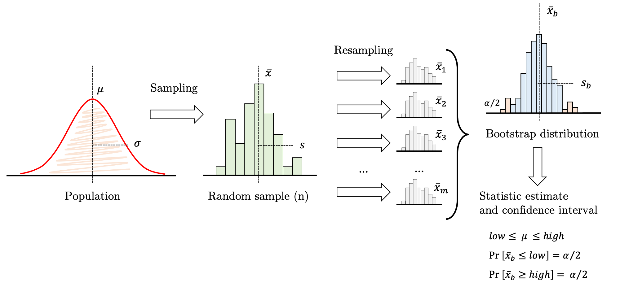
Bootstrapping

Slide 17
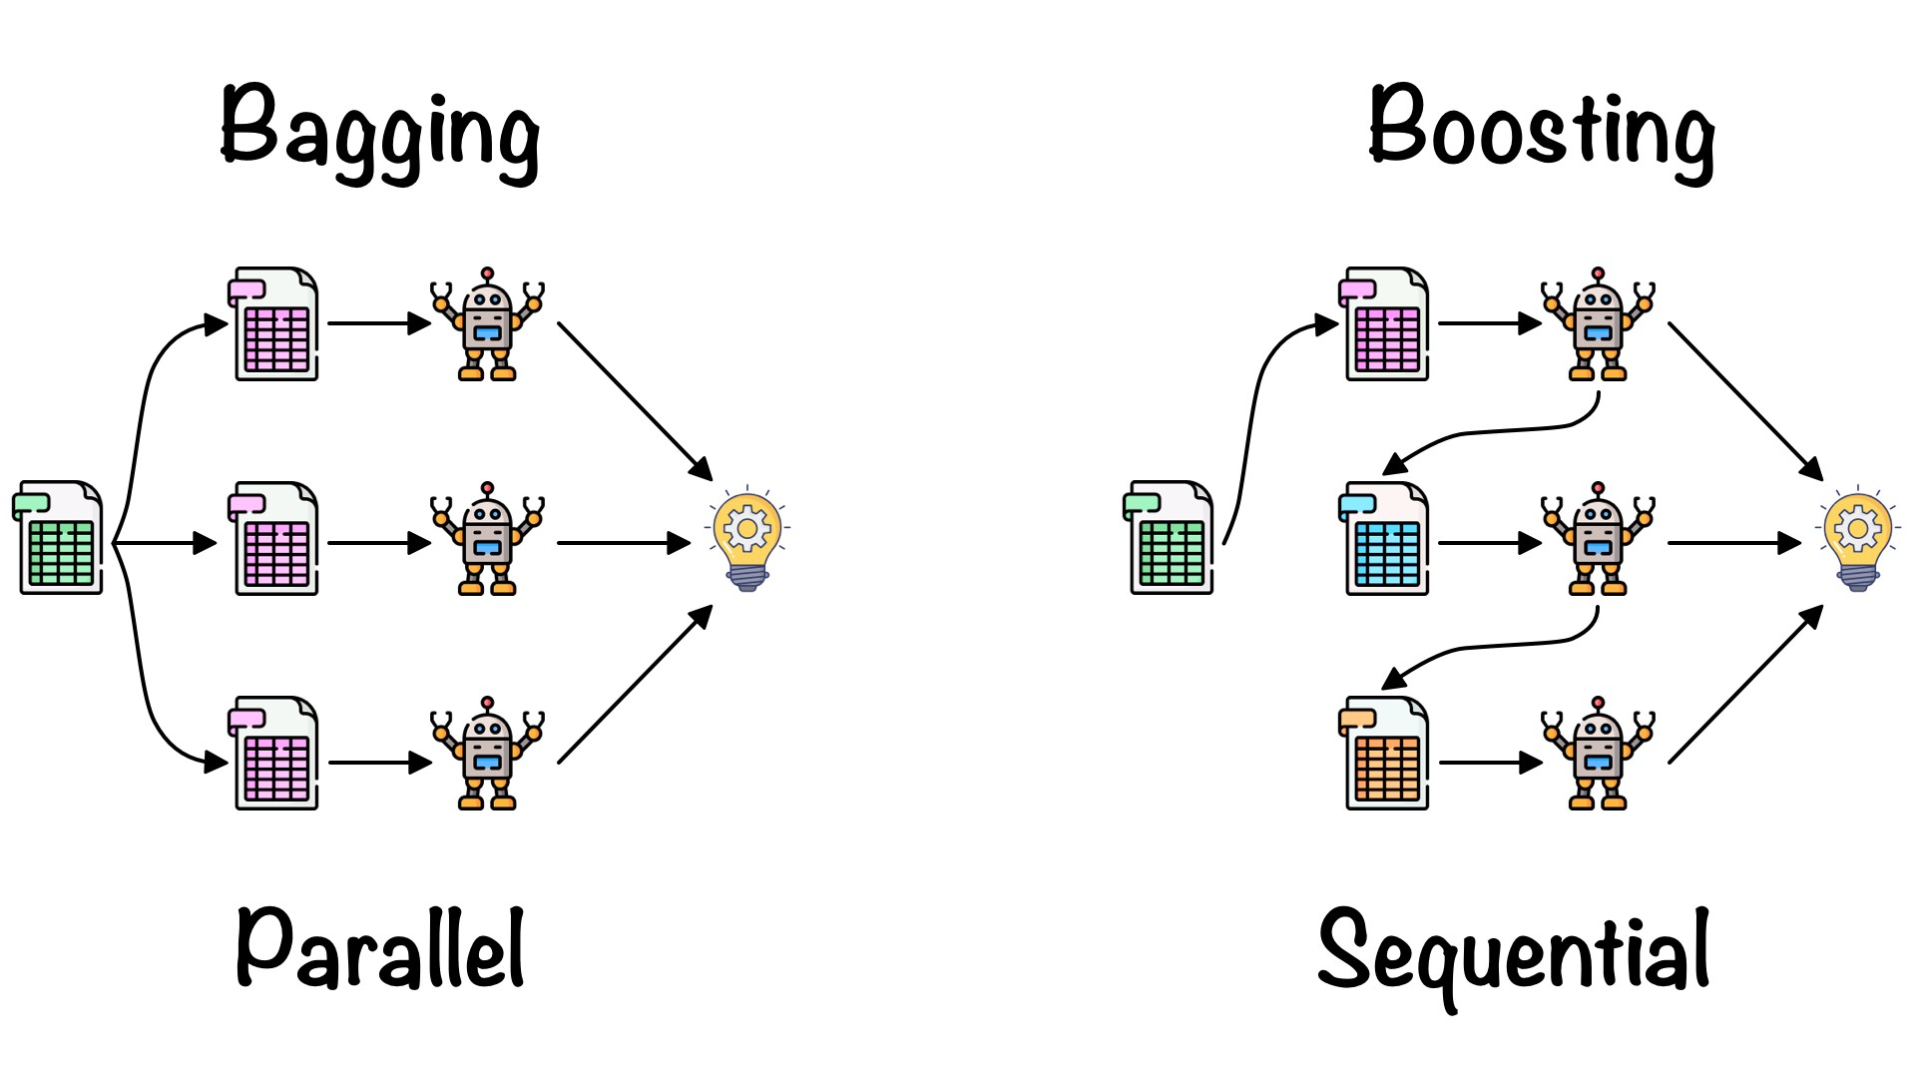
Bagging
Bootstrap Aggregation or Bagging, It is a widely used ensemble learning method to reduce the variance in a noisy dataset.
After generating random data subsets from the main dataset, multiple weak models are trained independently.
The random forest algorithm is an extension of the bagging method that uses both bagging and feature randomness to generate a random forest from unrelated decision trees.

Slide 18
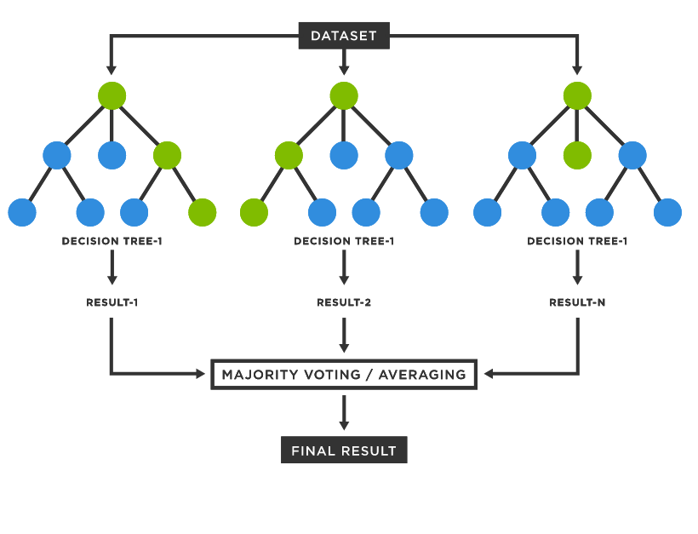
Random Forest
This concept operates under an ensemble method called bagging, in which multiple fit estimators can be combined to reduce the effect of overfitting.
Bagging uses a collection of parallel estimators, each of which fits the data well and averages the results to find a better classification.
A collection of random decision trees is known as a random forest.

Slide 19
Boosting
Boosting is an ensemble learning method that combines a set of weak learners into a strong learner to minimize training errors.
In reinforcement, a random sample of data is selected and then sequentially trained – that is, each model tries to compensate for the weaknesses of the previous one.
At each iteration, the weak rules from each classifier are combined to form a single strong prediction rule.

Slide 20
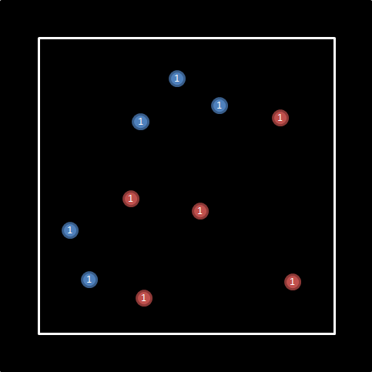
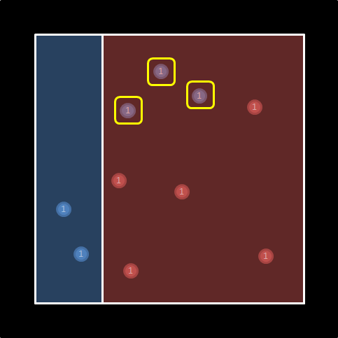
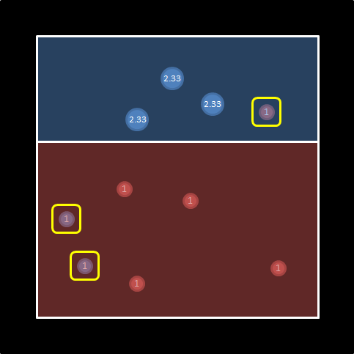
Boosting App
Source: https://medium.com/@sertacozker/boosting-algoritmalar%C4%B1-nas%C4%B1l-%C3%A7al%C4%B1%C5%9F%C4%B1r-edac1174e971
7/3 = 2.33
11/3 = 3.66

Slide 21
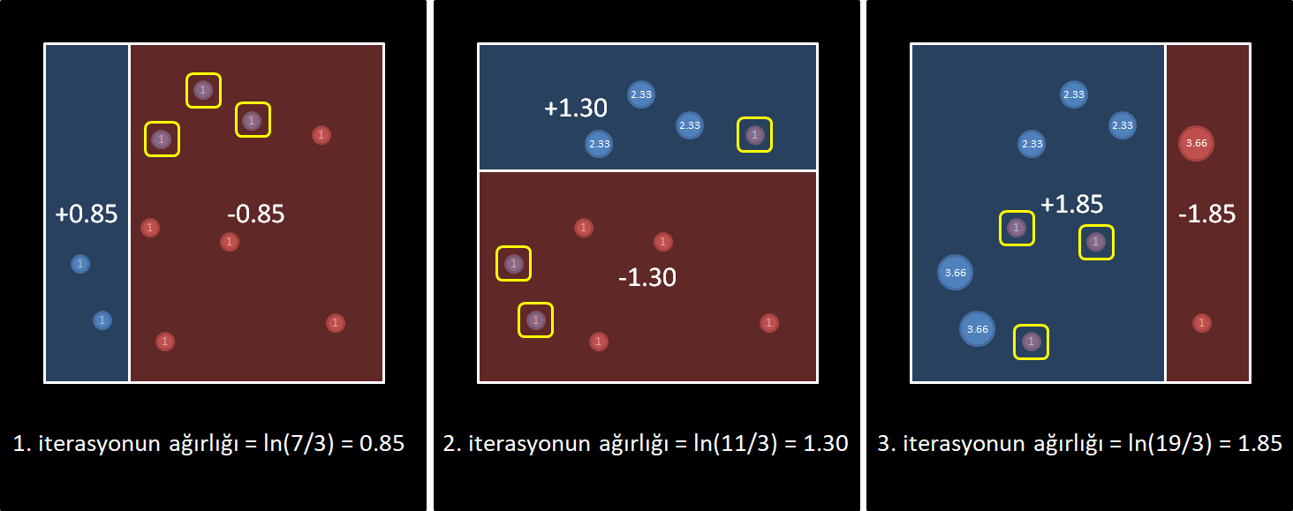
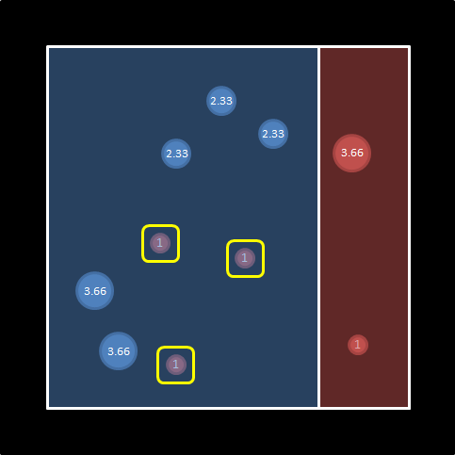
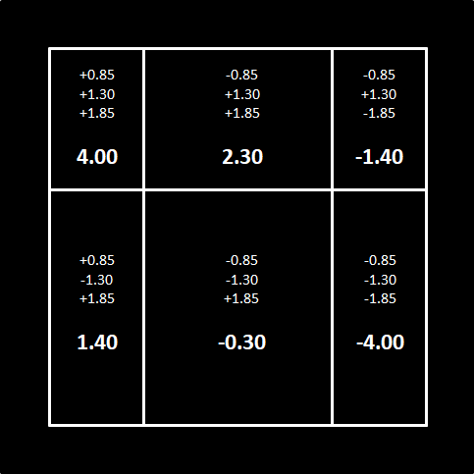
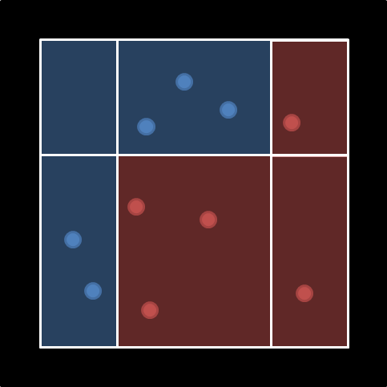

Slide 22
XGBoost

